Slide 1


Bisons Unchained Leveraging blockchain technologies for environmental protection, economic development and community empowerment in the context of the Carpathians in Romania Challenge: Bisons Token Philipp Brodmann, Nicola Hasenau, Sabria Karim, Michel Lim, Nicola Rüegsegger, Kevin Thommen, Neville Walo …

Slide 2
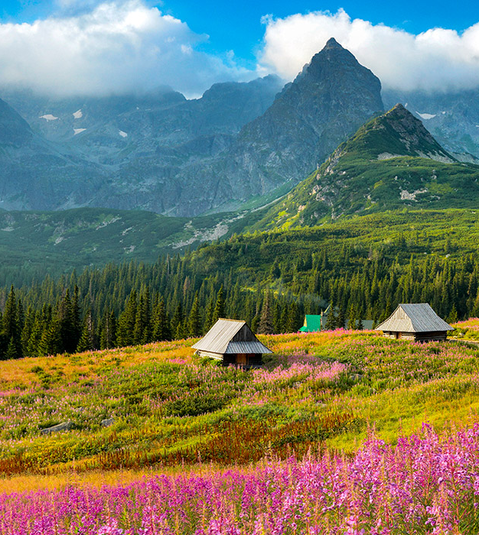

Use the model presented by WWF (“Wild AI”) as a starting point and build on it
Make the model self-reliant into perpetuity after initial funding, interlocking the well-being of the environment and the local community
Create new jobs and to train locals to fill them
Increase social well-being of local communities and enable a framework for local businesses to be created
Make nature accessible to tourists in an ecological and sustainable fashion (“ecotourism”)
Rate-limit incoming tourists, avoid mass tourism
Use distributed decision making and empower local communities by using voting tokens
Make all information about the health of the ecosystem tamper-proof and available to all parties
Use smart contracts to create incentives depending on the well-being of the ecosystem
Goal and Impact
https://redsearch.org/images/p/carpathian_mountains_hungary#images-3

Slide 3
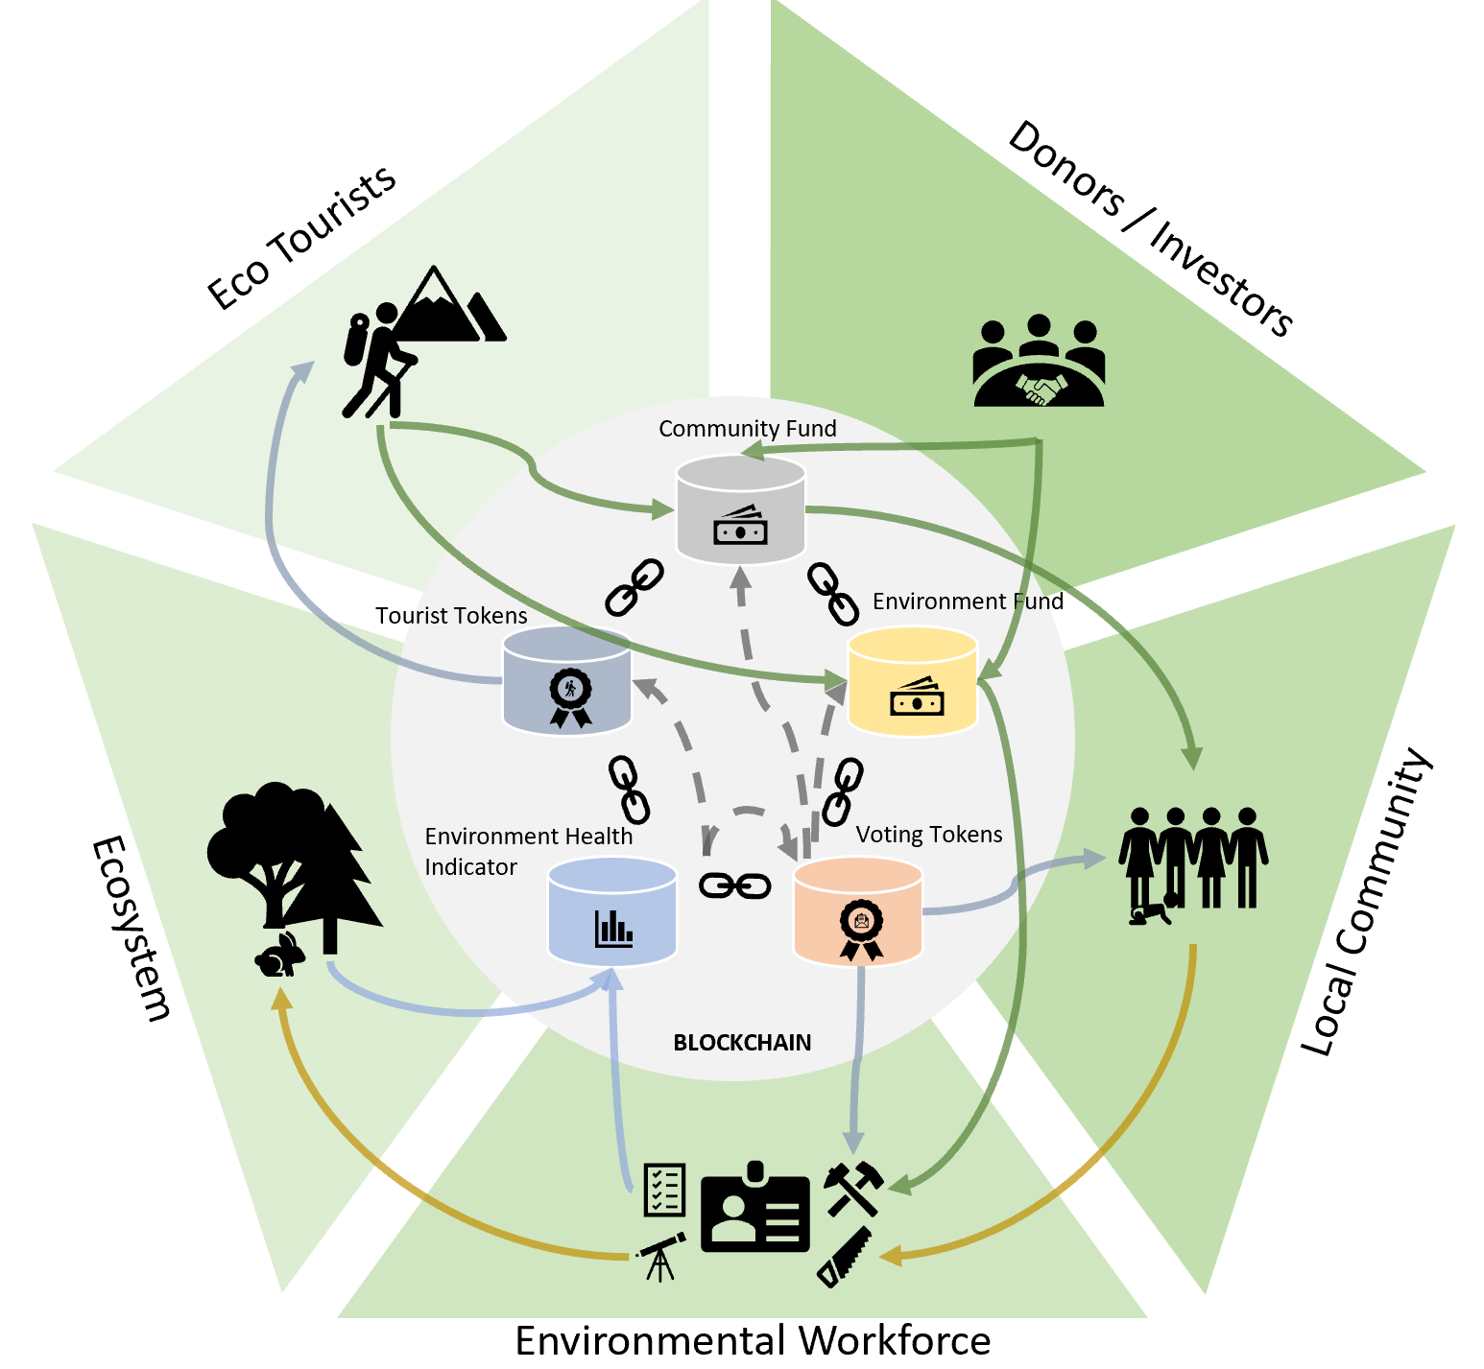
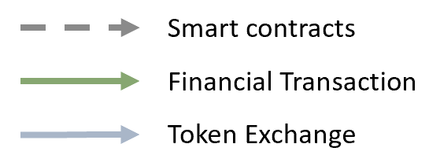
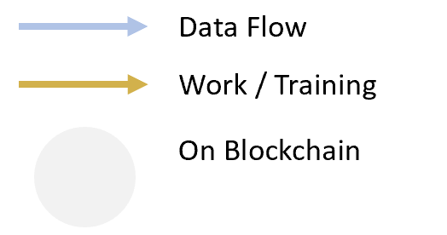
Bisons Unchained - Our Proposed Model
Make selected areas available for ecotourists to visit
Have a limited amount of Tourist Tokens sold to tourists for a certain amount of time, e.g. one week (similar to an entry fee or tourist tax)
Use the money from the sold Tourist Tokens to fund training of necessary staff (Environmental Workforce), community projects and all costs related to the Ecosystem (reforestation, access control, building and maintaining hiking trails, etc.)
Have an automatic pricing algorithm: the higher the demand for the Tourist Tokens the higher the price (similar to flight tickets)
People in the Environmental Workforce can earn Voting Tokens for certain actions which allow them to vote on how funds for the environment (Environmental Fund) and for the community (Community Fund) are spent -> empowerment, distributed decision making, incentive to participate
Continuous information about the health status of the Ecosystem (Environmental Health Indicators) are gathered, provided to all stakeholders and the public and used to power smart contracts: availability of funds in the Community Fund, the number of Tourist Tokens (decreases if the Ecosystem is in not doing well)

Slide 4
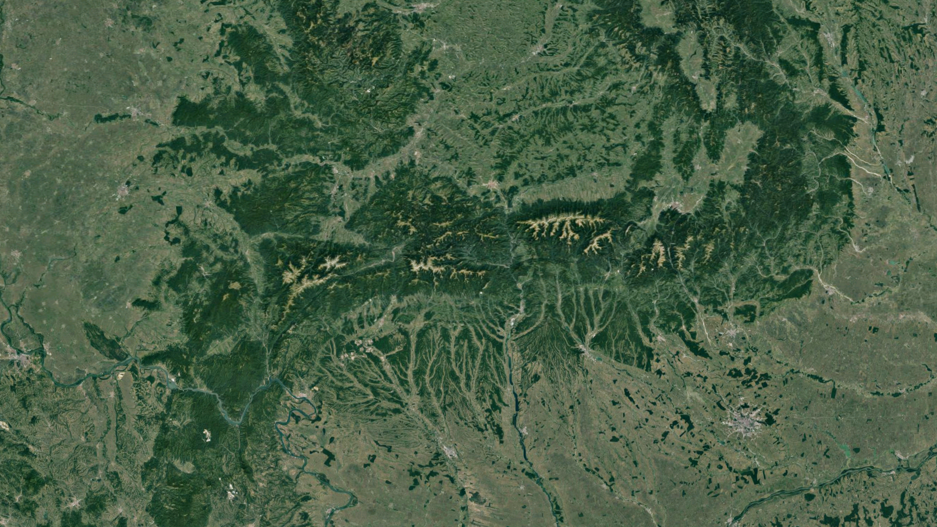

Disruption Potential
Protecting the environment becomes an integral part of the local economy
Money from donors has a multiplying effect into the future without the need for further funding
The positive impact of a project on nature becomes measurable, potentially motivating donors and investors
Ecosystem health indicators as well as ecotourists lead to a public eye with more pressure to preserve nature
Previously disadvantaged rural communities get access to education and training, jobs are created and a sustainable local economy gets established, potentially lasting for generations
Empowering the local workforce and democratizing decision making by a distributed, decentralized, and transparent process for fund allocation
Mass tourism is avoided while still generating more income if the demand is high (Tourist Token prices increase)
Difficulties / Open Challenges
The blockchain backbone can potentially delay processes, incur transaction costs and potentially use a lot of energy
The local legal, social and political system needs to be taken into account, potentially limiting / hindering implementation
Local workers need access to the internet and need a minimal computer / smartphone literacy
The Community Fund acts outside the established local political system which contains a potential for conflict
Information about the health of the ecosystem needs to be easily verifiable, otherwise there’s a conflict of interests (people in the Environmental Workforce might report too good findings in order to profit personally)
Smart contracts offer the possibility to make rules immutable which could make the whole system too rigid if circumstances change
There is no direct influence on how the ecotourists travel to the destination

Slide 5

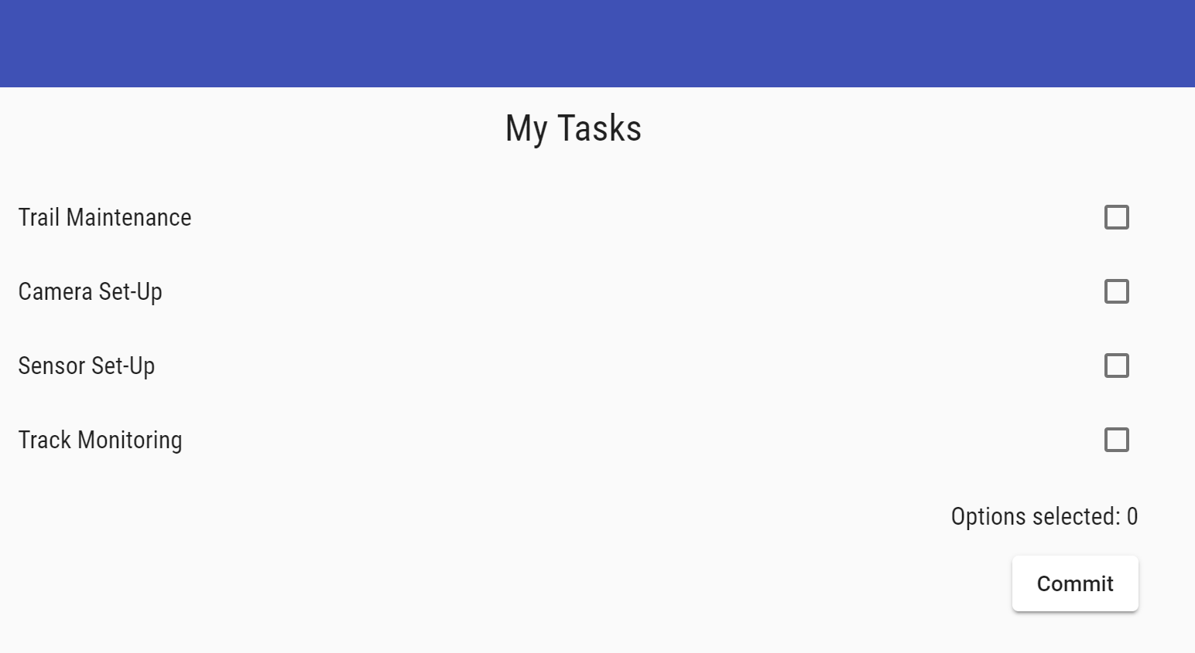

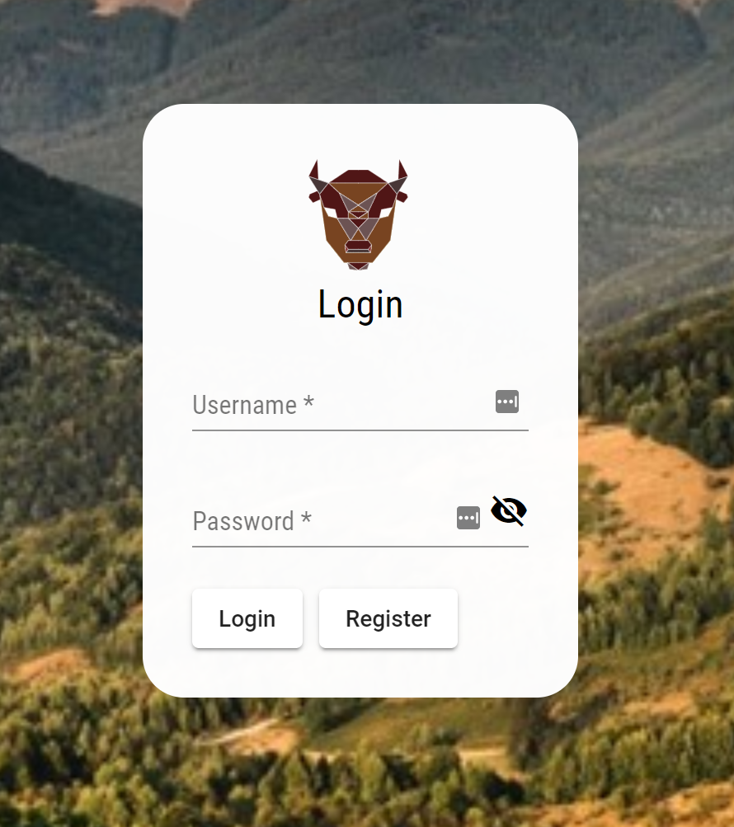
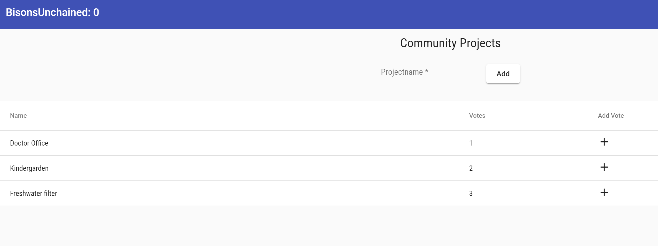
Proof Of Principle: Token Distribution and Voting System
Web Interface
Web3.js
Blockchain
Release of Tokens after verification by oracle (oracle not implemented)
Guarantee trustworthy voting process
Verify amount of Tokens actually available
Submit proposal and deploy to blockchain
Make submission of proposals transparent
Play Video

